Slide 1



Team no:06
DESIGNING WEBSITE TO E-CATERING SERVICE
GUIDED BY: Ms.S.MALATHY M.E.
Team Members
S.DHINAKARAN
(Reg. No: 19BCR013)
M.THAMBIRAJ
(Reg. No: 19BCR058)
R.BALAJI
(Reg. No: 19BCR061)

Slide 2
Table of contents
Abstract
Objective
Existing System
Drawbacks of Existing System.
Proposed System
Advantages of Proposed System.
System Requirement
Database Design
System Flow Diagram
Data Flow Diagram
ER Diagram
Schema Diagram
Module Description
Conclusion and Future Enhancement
Screen Shots
References

Slide 3
Abstract
E-Catering service that serves people all over with readymade foods. Currently this industry is going on with lot of flare.
People feel more comfortable with lot of variations in the selection and consumption of their foods in their busy life.
The project is to create a website for a e-food for bulk orders.
It is more effective for family functions and celebration.
The web application “DESIGNING WEBSITE TO E-CATERING SERVICE” is designed using PHP as front end and my SQL as back end.

Slide 4
This project is used to order foods through online.
Online payment will give option to the customer for online payment.
This will make catering buying experience cash free.
Better knowledge will provide customer all the details of his service before making service.
This confirmation will help customers to check the items service with their prices.

Slide 5
Objectives of the Project
To maintain online foods
To maintain food list
To reduce the billings and record errors
To improve customer satisfaction

Slide 6
Existing System
The existing system is partially developed website.
There are numerous issues in the current system. The current online catering service is not fully automated.
The key issue was keeping a database up-to-date.
All the details are managed using the website. In addition to that they are doing food list and order list by their own. It takes more time and effort.
So, there is a need to developing a new proposed system to overcome the drawback of existing system.

Slide 7
Drawbacks of the Existing System
No cart developed in existing system
Limited features
Invoice generate
Difficult to maintain order details

Slide 8
Proposed System
To overcome the drawbacks in the existing system, the proposed system is designed.
The proposed system is website based.
A web-based application that allows users to order food online is offered as a system.
Admin can prepare a report for analysing food sales data.
It can easily customize to the requirements of the admin.

Slide 9
Advantages of Proposed System
The proposed system has following advantages
Easy to maintain food and order details.
Provides easy and quick access over the data.
It also enables users all over the places to order the foods.
Orders would be verified online.

Slide 10
System Requirement
This section gives the details and specification of the hardware and software on which the system is expected to work.
Hardware Requirements
Processor | Pentium i3
RAM | 2 GB RAM
Monitor | 17” Color
Hard disk | 500 GB
Keyboard | Standard102 keys
Mouse | Optical Mouse

Slide 11
Software Requirements
Front End | PHP
Back End | MY SQL
Web Server | Wamp server
Operating System | Windows 10

Slide 12
Database Design
A database is an organized mechanism that has the capability of storing information through which a user can retrieve stored information in an effective and efficient manner.
The data is the purpose of any database and must be protected. The database design is a two-level process.
The organization of the data in the database is aimed to achieve the following two major objectives.
Data Integrity
Data independency
Database Design Table: team-6 review table.pdf

Slide 13
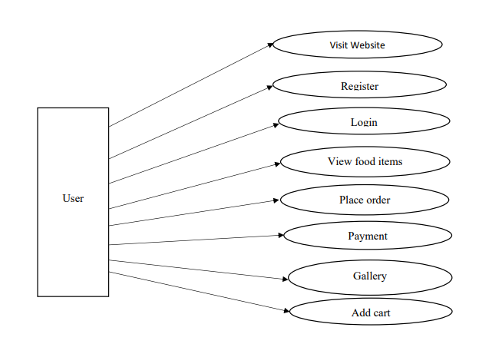
System Flow Diagram

Slide 14
Data Flow Diagram
DFD.PDF

Slide 15
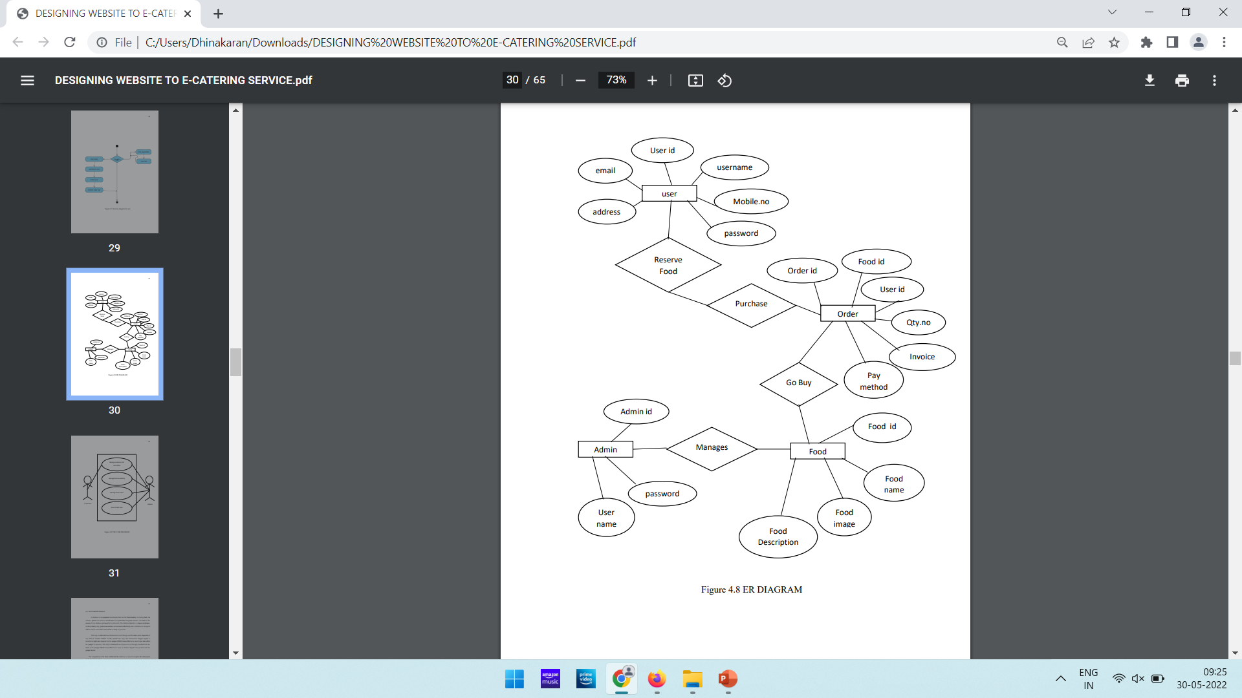
ER - Diagram

Slide 16
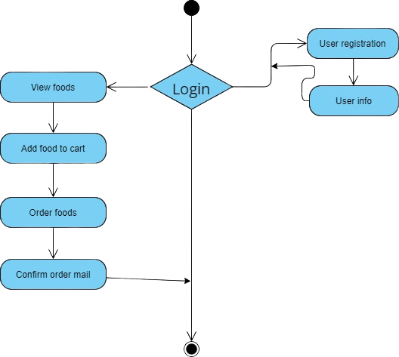
Usecase Diagram

Slide 17
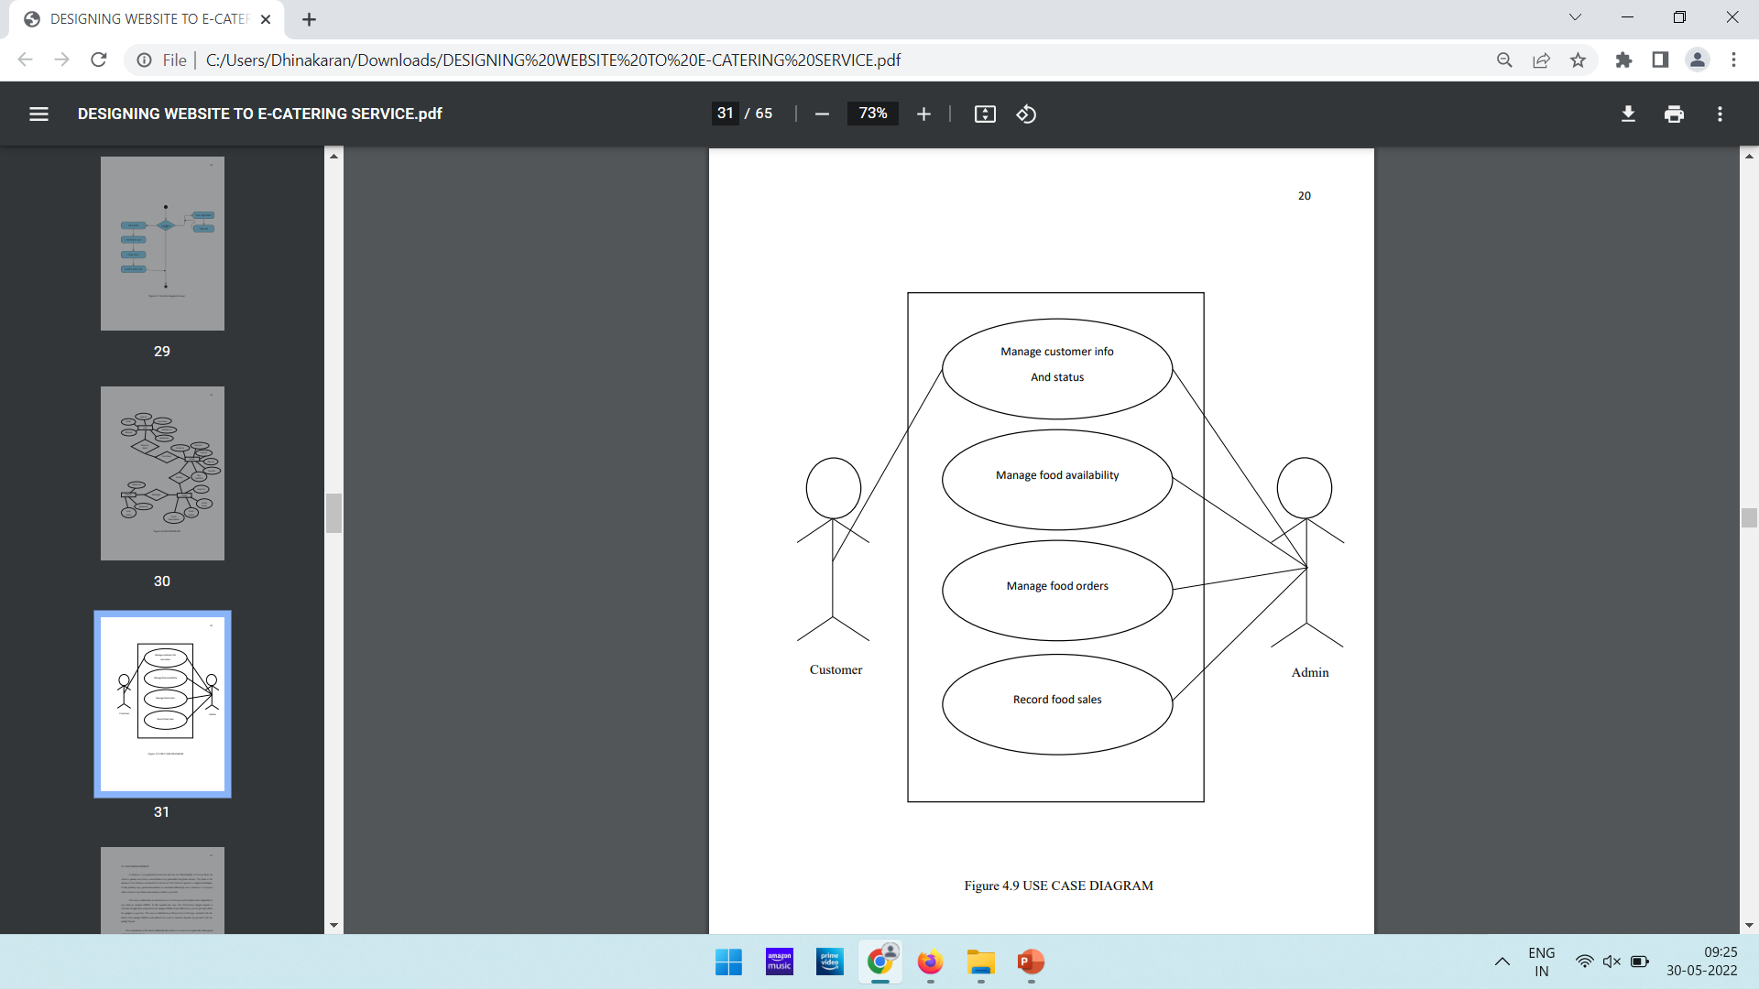
ER Diagram

Slide 18
Module Description
The project contains following modules
Add cart-Bulk Orders
Add cart-Individual Orders
Admin
Booking
Gallery
Review
Checkout-Bulk Orders
Checkout-Individual Orders
Menu
Notification

Slide 19
Module-1,2 Add cart(Bulk and Individual)
This module allows the customer to
Add foods to their cart
Module-3 Admin
This module allows the customer to
Add foods
Add pictures to their gallery
Generate reports
Generate invoices

Slide 20
Module-4 Booking
This module allows the customer to
Confirm their order with personal details
Module-5 Gallery
This module allows the customer to
View some images in gallery

Slide 21
Module-6 Review
This module allows the customer to
Give a feedback about their
Experience
Food quality ,etc
Module-7 Checkout (Bulk and Individual)
This module allows the customer to
Finalize their food items to order

Slide 22
Module-6 Menu
This module allows the customer to
Order and view the food items
Module-7 Notification
This module allows the customer to
Some alert notification regarding offers

Slide 23
Conclusion
The project helps administrator to maintain all orders and details.
It reduces the manual work.
The application is designed as website, any employee can be using the website.
The application is tested well and end user satisfaction is found to be more. The application designed such that minimum computer knowledge is required for the end user.

Slide 24
Future Enhancements
The application become useful if the below enhancement is made in future.
The consolidate complaints details can be get from customer.
Offers are will be sent to the customer mail The application is developed such that above said enhancements can be integrated with current modules.

Slide 25
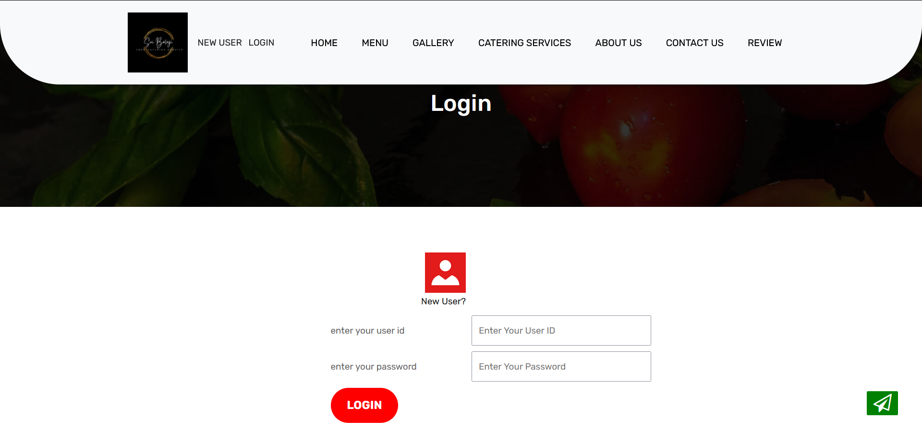
Screen Shots
Login Page

Slide 26
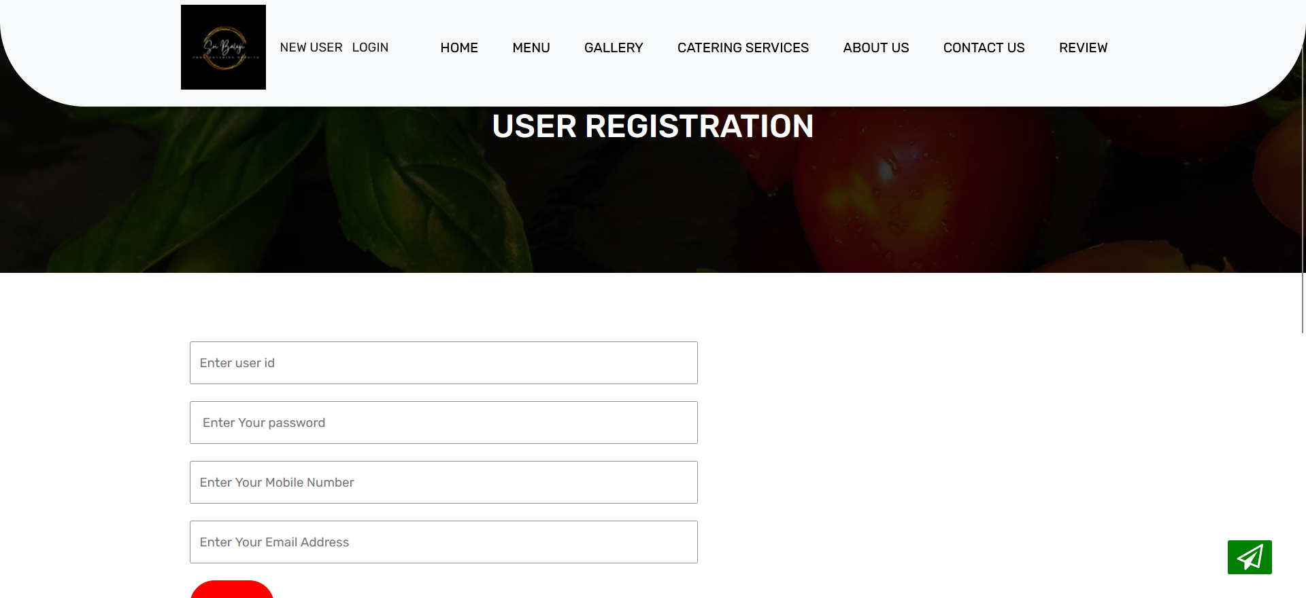
Screen Shots
User Registration Page

Slide 27
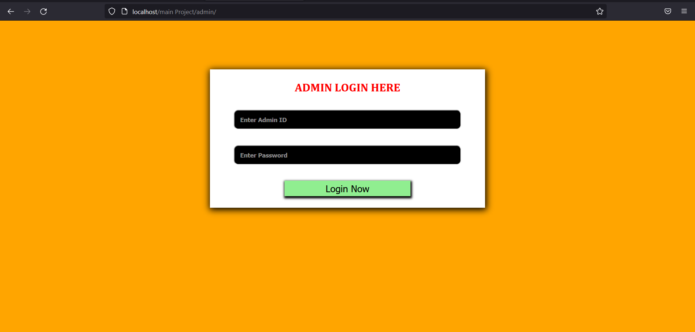
Screen Shots
Admin Page

Slide 28
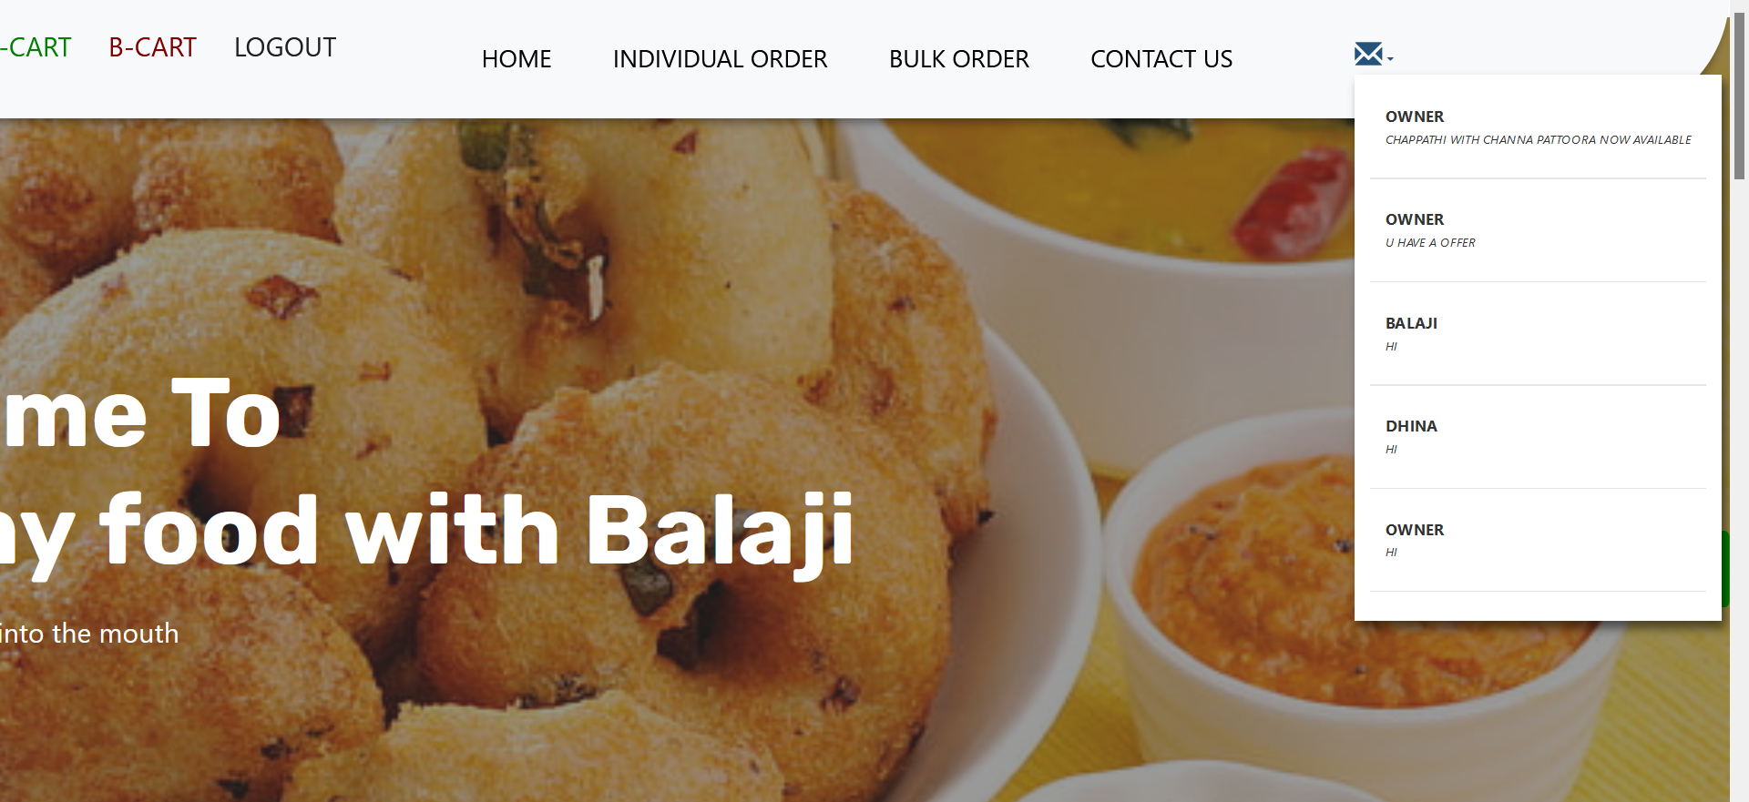
Screen Shots
Notifications

Slide 29
References
Kevin Yank (2015),’PHP &MySQL Novice to Ninja’ Fifth edition, Shroff Publishers & Distributers Private Limited.
Luke Welling and Laura Thomson, “MYSQL Web Development-developer Library”, 2nd Edition.
Luck Welling & Laura Thompson (2016),’PHP & MySQL web Development’ Fifth Edition, Pearson Education.
Mario Lurig (2017), ‘PHP: Beginner’s to Intermediate PHP5’ First Edition, McGraw Hill Education
www.w3school.com ,’Learn PHP and HTML’

Slide 30
THANK YOU

